Slide 1
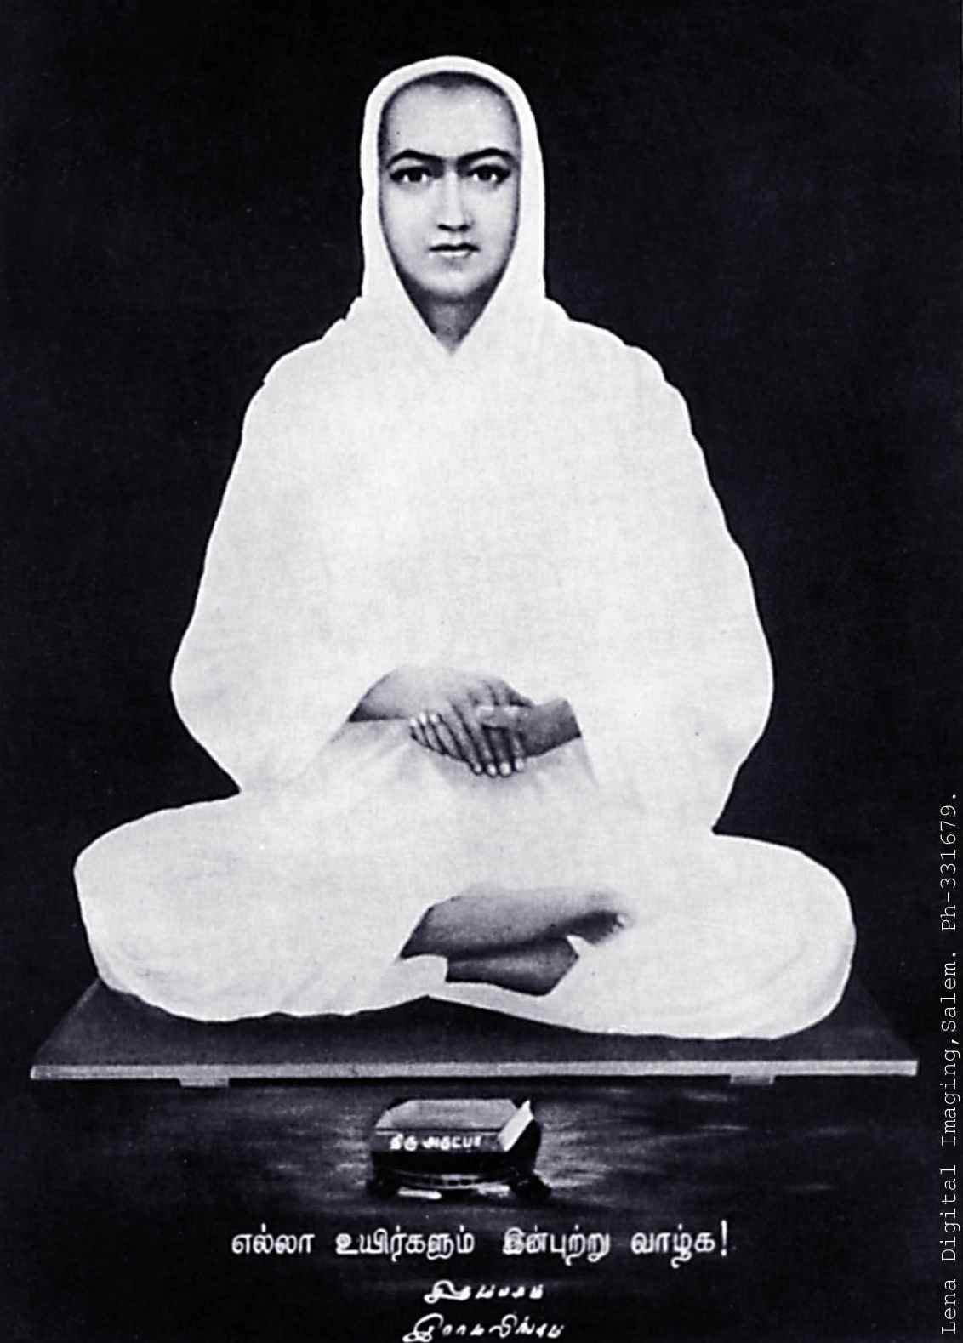

Story and philosophy of Ramalinga Swamigal (Vallalar)
— and why they matter to you.
A path of compassion, open to all human beings, regardless of tradition, religion, social and economic status, age and any other barrier.
Presented by SANMARKKAM LIFE · sanmarkkamlife.org

Slide 2
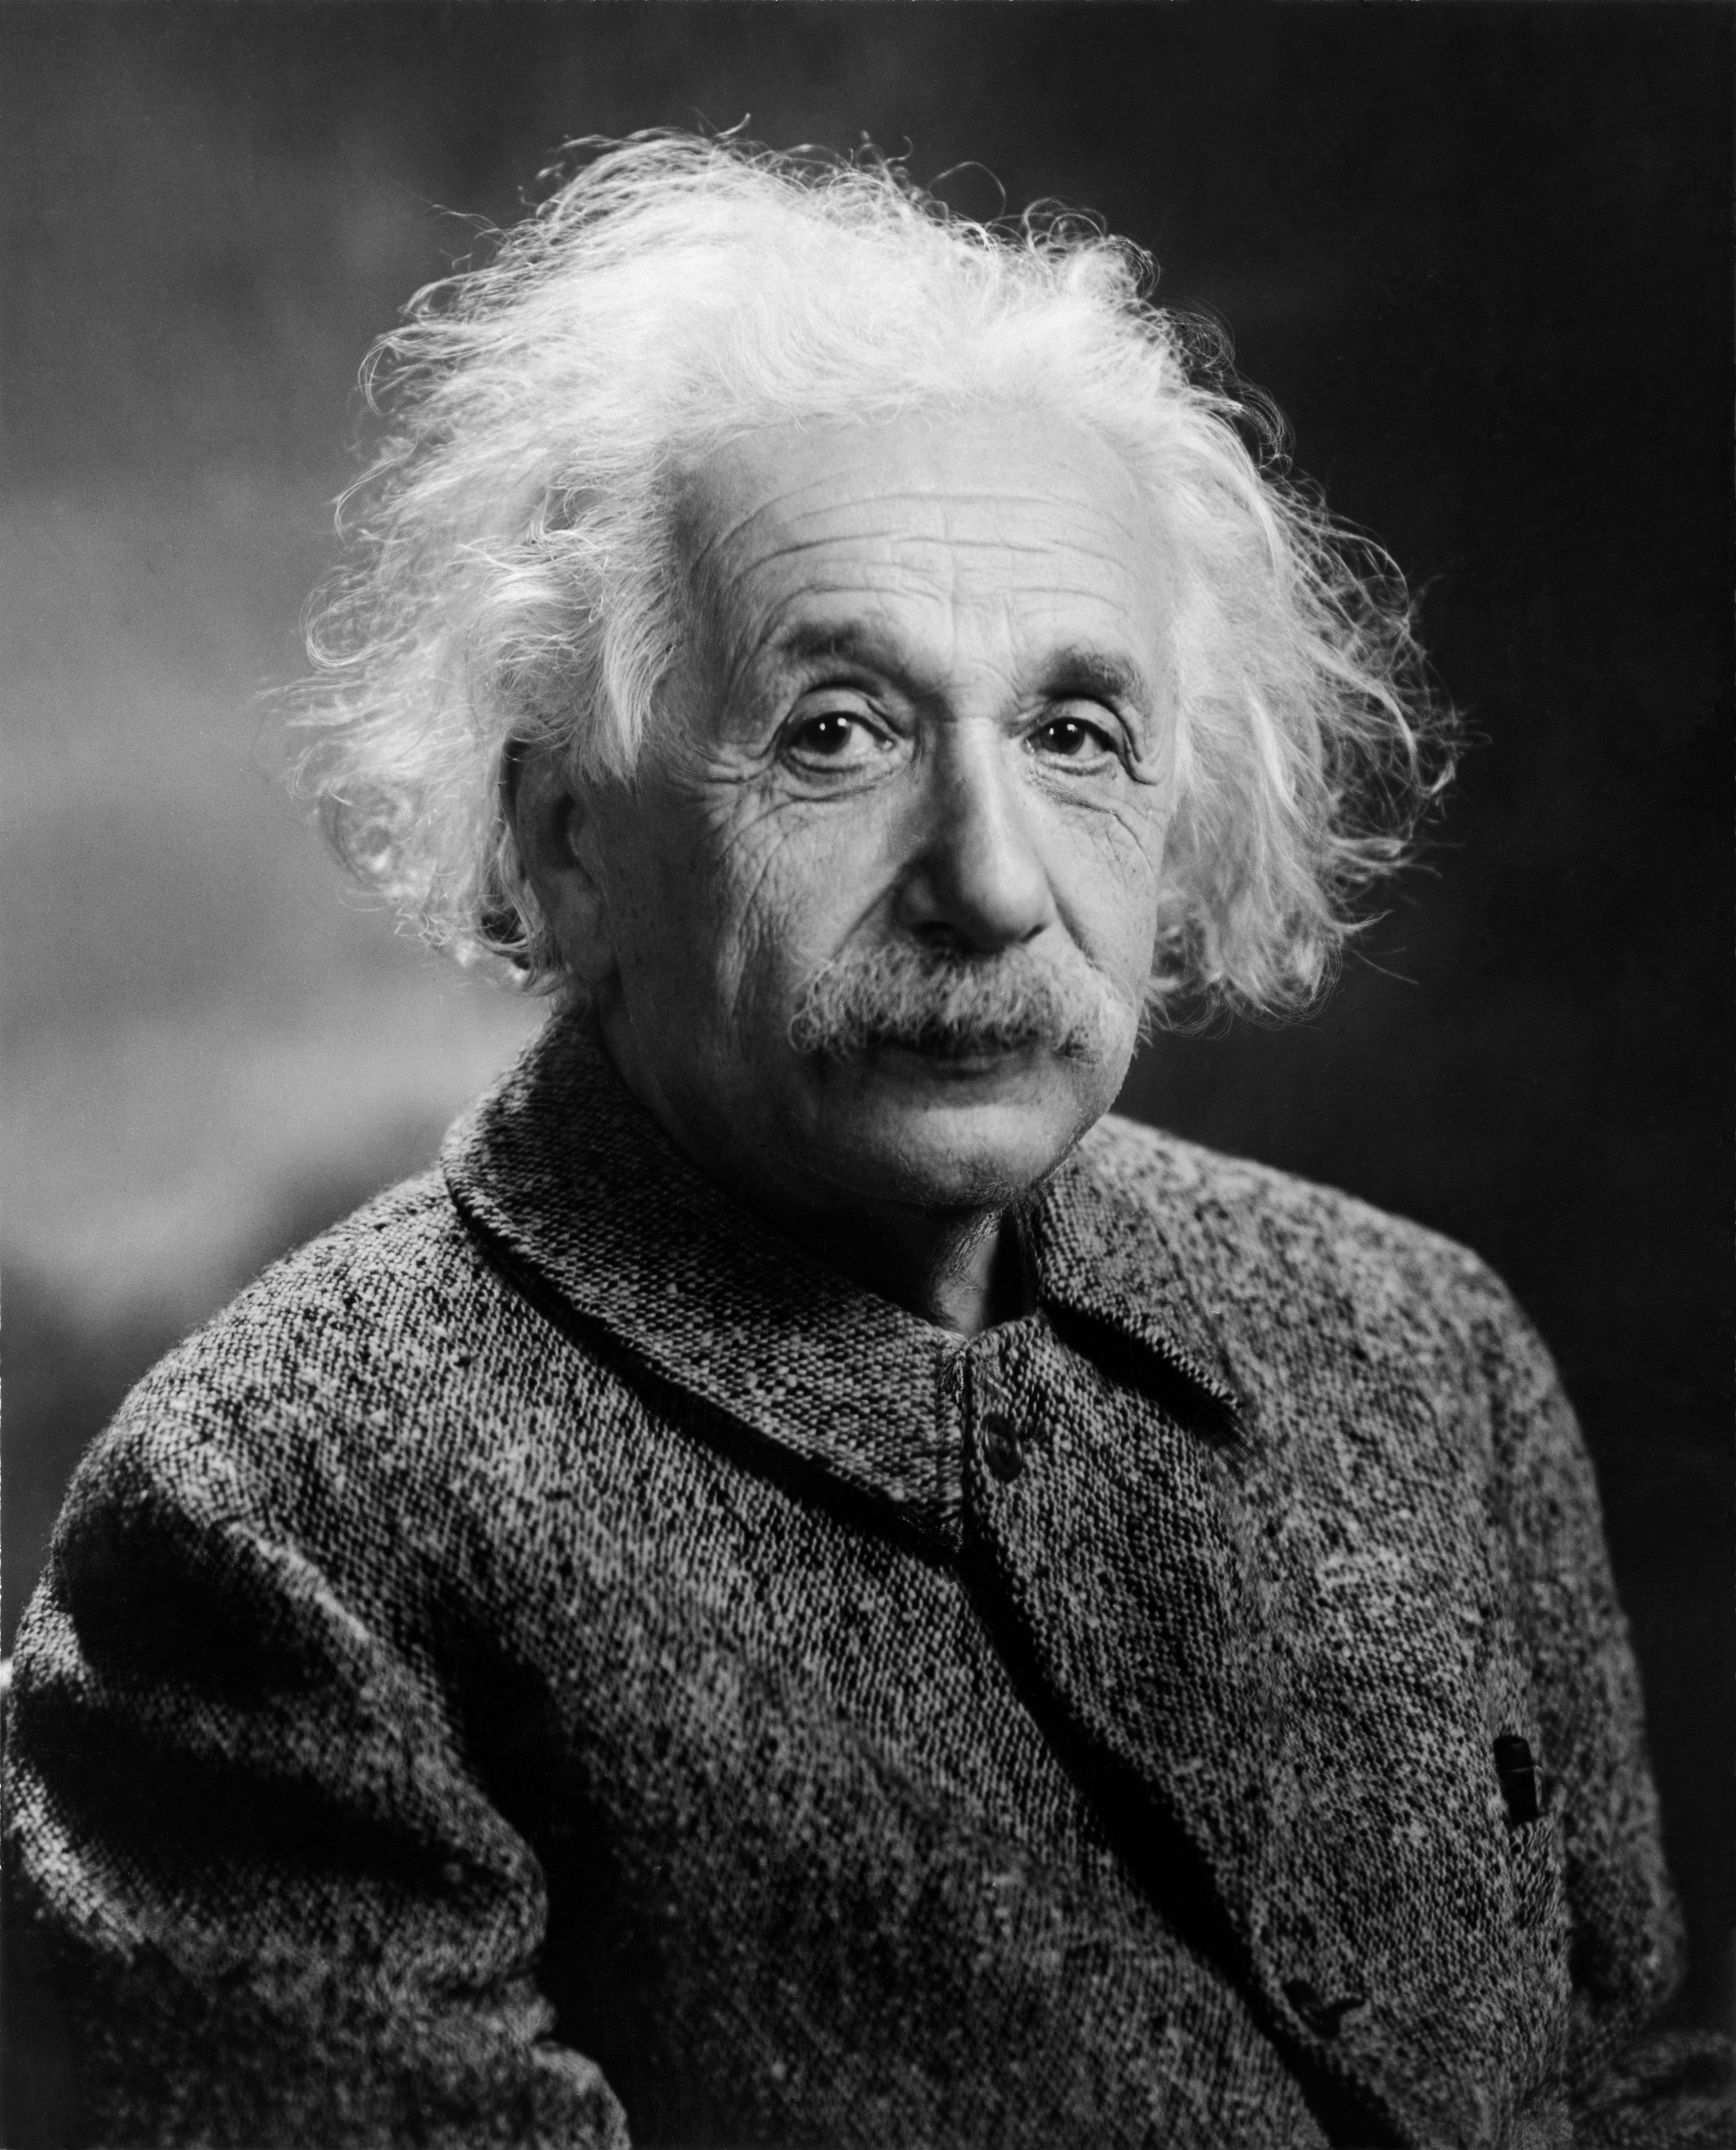
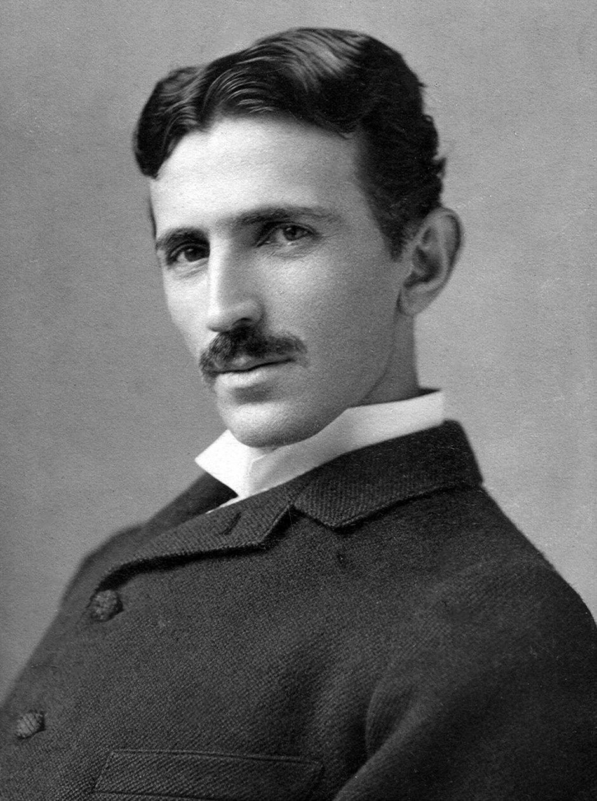
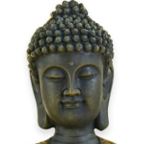
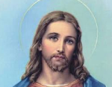
Imagine one single figure who carried...
🧠
⚡
Albert Einstein
Nikola Tesla
The mastery of the 5 elements (panchaboothas) of fire, water, air, earth, ether.
Experience (anubhavam) and replication of results as the main compass. No religious dogmas. No superstitions. A science – Said by Vallalar and reported by his disciple Toluvur Velayuda Mudaliar
🪷
❤️
Buddha
Jesus Christ
The boundless compassion toward all living beings. Not limited to humans, but also to animals, micro – life and even the vegetable kingdom – I withered by seeing a crop wither.
An unconditional love (Anbu) towards all life. Without Love, Compassion (Jeeva Karunya) cannot exist.
A man who went further than all of them. Not by theorizing. By living it.

Slide 3
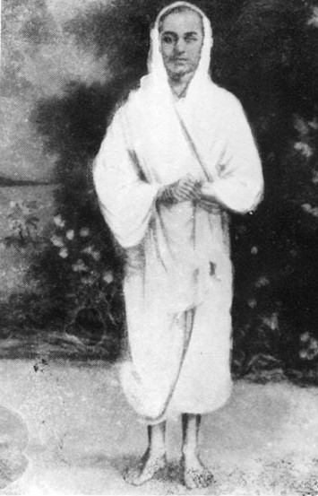
RAMALINGA SWAMIGAL · 1823 – 1874
A Scientist. A Doctor. A mystic. A poet. A Social Reformer. An Animal Advocate. A precise Prophet
He made his own body his laboratory. A vast knowledge about medicine. Devoted to the all-permeating Vast Grace Light Against the cast system and inequality. A skilled poet author of the Thiru Arutpa. Against killing for food and rituals. So far hasn’t failed any prediction.
1823
1867
1872
1874
Born · Maruthur, Tamil Nadu
Founded free kitchen · Vadalur
Sathya Gnana Sabai · Vadalur
Documented disappearance
sanmarkkamlife.org

Slide 4
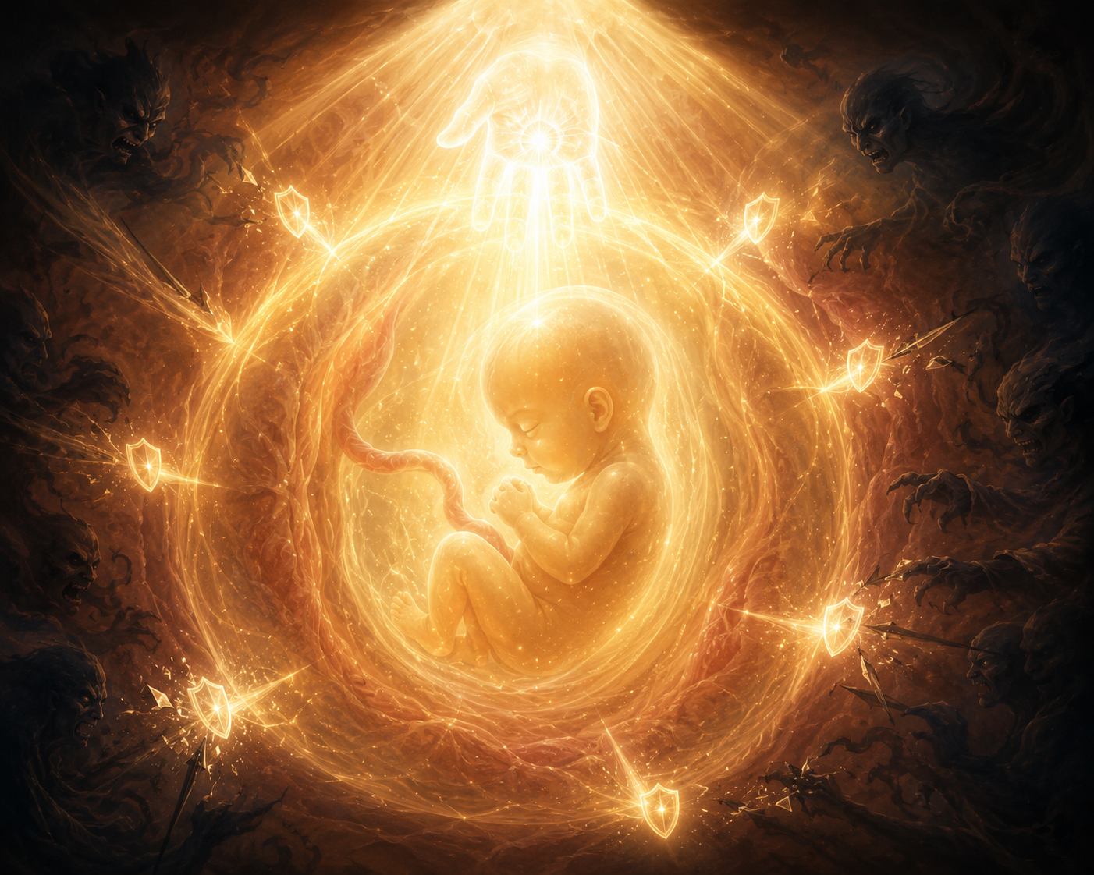
ORIGIN · BEFORE BIRTH
His life was itself sparked by compassion.
The Blessing
A wandering Shaivite devotee came at noon — hungry, begging at Chinnammaiyar’s door. Without hesitation, she fed him. The sage blessed her: “You will bring into this world a son who will be a boon to all of humanity.” He then vanished mysteriously. Vallalar was born from compassion itself.
Peru Vinappam
Vallalar reveals that long before birth, the Divine Inner Light was actively present within the womb—safeguarding his conception from nefarious agents, orchestrating his physical formation of a superior body and mind and consciously preparing his body to become a vessel for universal grace
Born
October 5th, 1823 - Maruthur, near Chidambaram, Tamil Nadu. His father Ramaiah Pillai passed away before he could witness his son’s greatness . Ramalinga was raised by his mother Chinnammaiyar and his elder brother Sabapathi.
Based on the poem Peru Vinappam
sanmarkkamlife.org

Slide 5
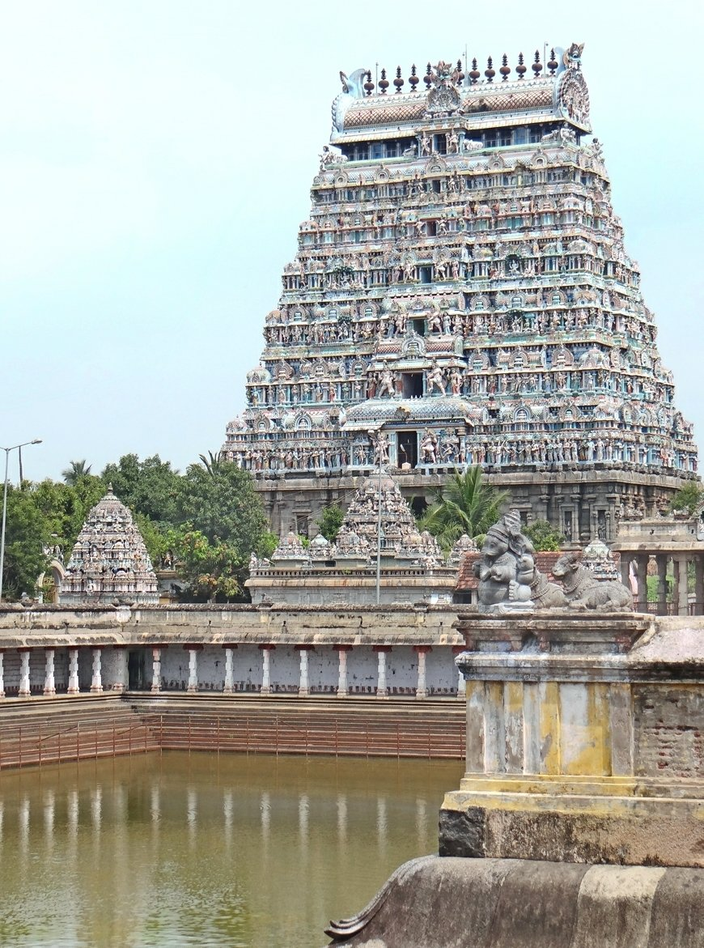
EARLY LIFE · 1823 – 1847
The Prodigy Child
5 months
At the Chidambaram Temple, the priest Sabapathy Sivacharya performed the Deepa Aradhana — the blessing with a lighted lamp. The child giggled with delight. The priest said : “This was no ordinary infant's reaction to light” “As soon as light was perceived, happiness prevailed on me – Vallalar”
Age 9
Confined to a room with only a mirror and an oil lamp, he entered states of deep trance. From that room emerged his first poem. He refused traditional schooling from his brother.
Adolescence
His verses circulated among the scholars of Madras. A renowned pundit from Kanchipuram declared there was nothing he could teach a being who possessed the innate capacity to instruct the world. Nobody could explain where this knowledge came from.
sanmarkkamlife.org
Chidambaram Nataraja Temple

Slide 6
DOCUMENTED WITNESSES
Unexplainable accidents.
Devanayakam Pillai — Alchemical Transmutation (Yema Siddhi)
A devotee named Devanayakam Pillai was obsessed with alchemy. To teach him a lesson, Vallalar effortlessly converted an iron sheet into sixteen-carat gold — then immediately threw it away. He told the devotee: “Such knowledge only comes to those completely without desire for wealth”. He considered it a trivial gain.
Sabapathy Sivacharya — Immunity to Fire
Sabapathy Sivacharya, a priest and disciple, witnessed a bowl of burning coke fall onto Vallalar’s thigh. The priest burned his own hands attempting to brush the coals away. Vallalar’s skin and clothing remained completely unmarked and unharmed.
sanmarkkamlife.org

Slide 7
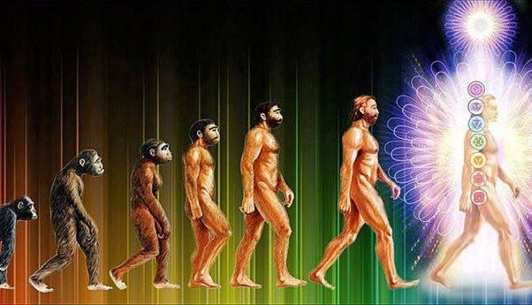
SAHAKALPI · THE SCIENCE OF DEATHLESSNESS · 01
Is this what comes after homo sapiens sapiens?
“The wretched wrinkles are gone. The bones and tendons have become supple.”
— Ramalinga Swamigal, Thiruarutpa
1 Suddha Degam — The pure physical body. Free from disease and decay.
2 Pranava Degam — The body of pure vibration. Beyond ordinary matter.
3 Jnana Degam — The body of pure wisdom. Eternal, omnipresent, omniscient, omnipotent
Historical witnesses and his Thiru Arutpa and Urainaidai, report Vallalar’s changes in body. They reported the skin of a newborn on a man in his fifties. Immunity to elements like fire, no shadow cast, He said this was the result of compassion — and a grace open to every human being.

Slide 8
SAHAKALPI · THE SCIENCE OF DEATHLESSNESS · 02
01
Suddha Degam The Purified Physical Body
The body operating outside ordinary biological parameters. Progressive purification — aging, disease, and physical decay reversing over time. No shadow cast
Absence of Excretions: The body transcends gross biological limitations and ceases to produce any waste or secretions, including mucus, feces, urine, and even sweat.
Purushottama Reddiar — Personal attendant
Served Vallalar at Karunguzhi, Vadalur, and Mettukuppam. Bore witness across years to the progressive transformation of Vallalar’s body. The skin returning to the smoothness of a newborn’s, physical decline reversing rather than advancing.
Ayyasamy Pillai — Cuddalore
Standing beside Vallalar in direct sunlight, looked down and saw his own shadow on the ground. Vallalar cast none. The body had become suffused with inner light . No longer fully opaque to the sun.
“The wretched wrinkles are gone. The bones and tendons have become supple.”
— Ramalinga Swamigal, Thiruarutpa

Slide 9
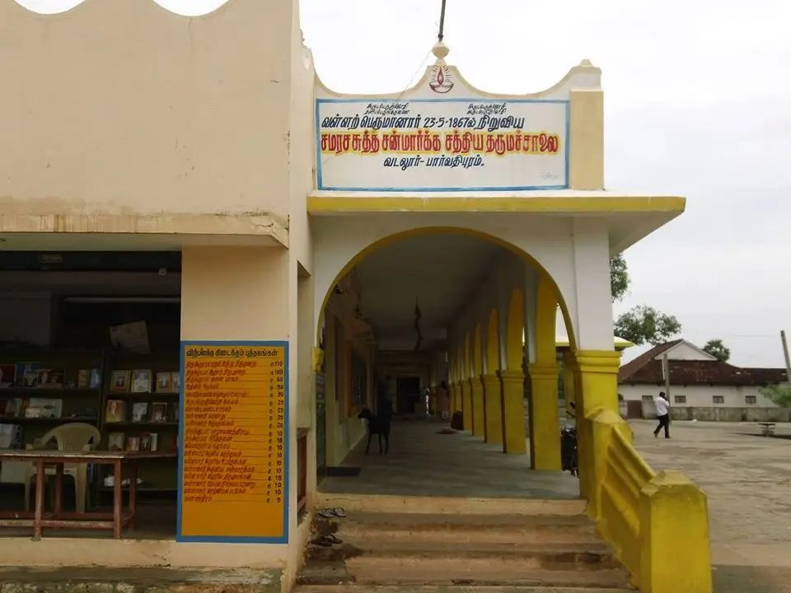
1867 · VADALUR, TAMIL NADU · SATHYA DHARMA SALAI
A free meal. For anyone.
No conditions.
In 1867, Vallalar opened the Sathya Dharma Salai Kitchen and fed whoever walked through it. Regardless of caste, religion, socio–economic status etc. He called it Para Jeeva Karunyam , the primary act of compassion of removing the fire of hunger and death. Because you cannot focus on your soul when you are in pain from hunger. The kitchen still runs today thanks to the donations coming in.
Sathya Dharma Salai — Vadalur, Tamil Nadu
1867
Founded
150+
Consecutive years
Proof that by giving freely, more comes.
365
Days/year
₹0
At the door
sanmarkkamlife.org

Slide 10
THE PATH · SAMARASA SUDDHA SANMARKKAM
The 3 Pillars of Suddha Sanmarkkam
A community of equals, walking a pure path, toward the liberation of all living beings from suffering.
Arut Perum Jothi
Jeeva Karunya
Atma neya Orumaipadu
THE VAST GRACE LIGHT
COMPASSION FOR ALL LIFE
UNIVERSAL SOUL ONENESS
The practice. The path. The daily science. Active compassion toward every creature, every plant, every form of life. Jeeva (living being) Karunya (compassion)
Atma (soul) Orumai (Unity) The interconnectedness of all Life. Hurting one being hurts you, helping one other helps you.
The one formless divine entity, all permeating — compassionate, accessible to all, regardless of tradition or background.
sanmarkkamlife.org

Slide 11
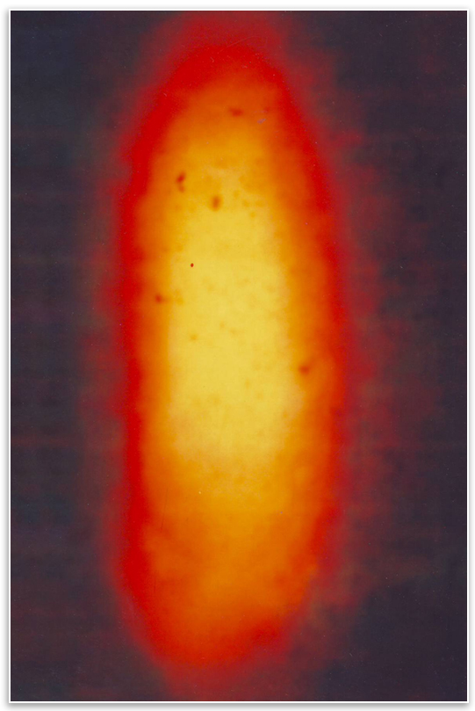
THE CENTRAL REALITY
Arut Perum Jothi
The Vast Grace Light
The Supreme Compassionate Entity
A living, intelligent, compassionate entity — the causal source of the physical universe — directly accessible within every human being, right now.
Beneath all matter, there is a field.
Modern physics describes an intelligent, interconnected field from which all physical reality emerges. Vallalar named it two centuries before quantum physics gave us the language.
It responds to compassion.
Not to ritual. Not to prayer in any language. To genuine, active compassion toward all living beings. The more you expand it — the more the Light flows through you.

Slide 12
1865 · VADALUR · THE ORGANIZATION HE FOUNDED
Samarasa Suddha Sanmarkkam Satya Sangam
An organization open to every soul. No caste. No religion required. No intermediary between the individual and the Divine.
Samarasa
Equal harmony. All genuine paths share one truth. No tradition holds a monopoly on the Divine.
Suddha
Pure. A path free from ritual, superstition, caste, and hierarchy.
San-markkam
The good path. San (goodness) + markkam (the way). The path of genuine compassion toward all life.
Satya Sangam
Association of Truth. A community of equals - not followers of a guru, no central figure, but seekers walking together.
Why he founded it.
In a society rigidly divided by caste, Vallalar created an organization that admitted all souls, regardless of religion, birth, wealth, or background. He established it to demonstrate that liberation from suffering, aging, and death was not the privilege of a chosen few. All souls are part of Arut Perum Jothi without discrimination.
sanmarkkamlife.org

Slide 13
MORE UNEXPLAINABLE PHENOMENA
Four documented incidents. Four different witnesses.
The Lamp That Burned on Water
At the Sathya Dharma Salai, Muthiyalammal
placed water beside the lamp instead of oil. Vallalar, absorbed in writing, mechanically refilled the lamp with it. The flame burned brightly until morning. Documented by Thozhuvur Velayuda Mudaliar.
Commanding Rain
During a severe drought in Vadalur, Vallalar instructed devotees to pour a vessel of water over his feet. Shortly after, a heavy downpour began, providing immediate relief from the drought.
Taking on Others’ Sickness
Eleven followers at the Dharma Salai fell ill with severe fever. Vallalar entered a room alone. Witnesses noted his body became as hot as fire, as if taking their fever. Minutes later he emerged in perfect health. All eleven were instantly cured.
Feeding One Hundred Unexpected Guests
Shanmugam Pillai, manager of Dharma Salai told Valallar that there wasn’t enough rice to cook. The Swami sat alone for a few seconds and then assured him that rice would come soon. Then, A devotee from Tirutturai brought loads of rice. He said vallalar asked
in his dream the night before, to bring the food.
sanmarkkamlife.org

Slide 14
SAHAKALPI · THE SCIENCE OF DEATHLESSNESS · 03
02
Pranava Degam The Body of Primal Sound
The second stage. The body is rebuilt — not made of flesh or bone — but of pure sound and elemental grace. What it becomes defies every physical law.
It Appears as a Luminous Child: Witnessed as a radiant child
It Cannot Be Touched
The Pranava Dekam is visible to the eye but imperceptible to touch, like reaching for space. It passes through solid walls at will. It is present in the world. But unreachable.
It Can Revive the Dead
Countless Siddhis (powers) . Among them: the power to revive someone dead and buried for up to 108 years. Lifespan granted: 311,040 billion years.
“Visible to the eye. Imperceptible to the hand. Present in the world. Bound by none of its laws.”
— Source texts on the Pranava Deham

Slide 15
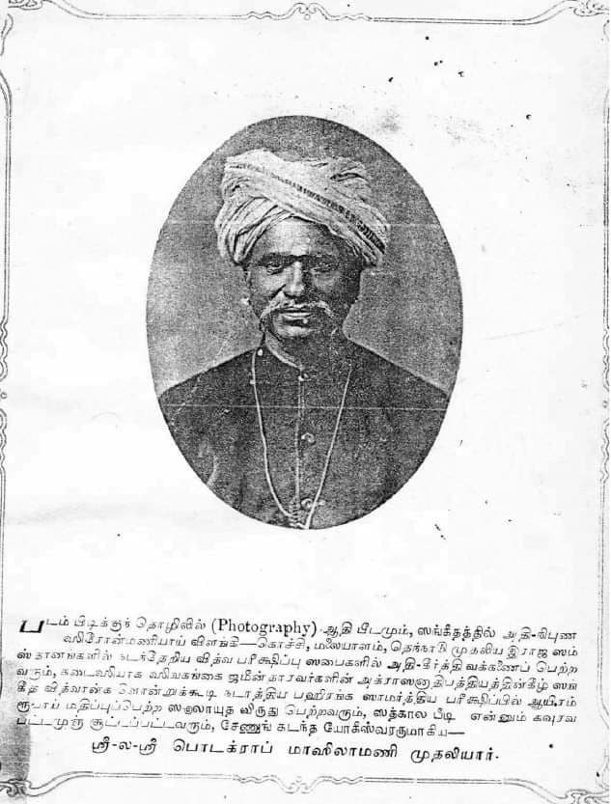
DOCUMENTED WITNESSES
More unexplainable accidents
Ayyasamy Pillai — Cuddalore
Standing beside Vallalar in direct sunlight, he looked down and saw his own shadow on the ground. Vallalar cast none. The body had become suffused with grace light. It was no longer fully opaque to the sun.
Masilamani Mudaliar — Madras Photographer
Using the finest photographic plates of the 19th century, he attempted to photograph Vallalar eight-nine times. Each plate returned the same: a white garment and a luminous outline where a body should have been. That explains why there are no pictures of him, just portraits, despite photos available of other saints like Vivekananda and Ramakrishna
Photo of Masilamani Mudaliar

Slide 16
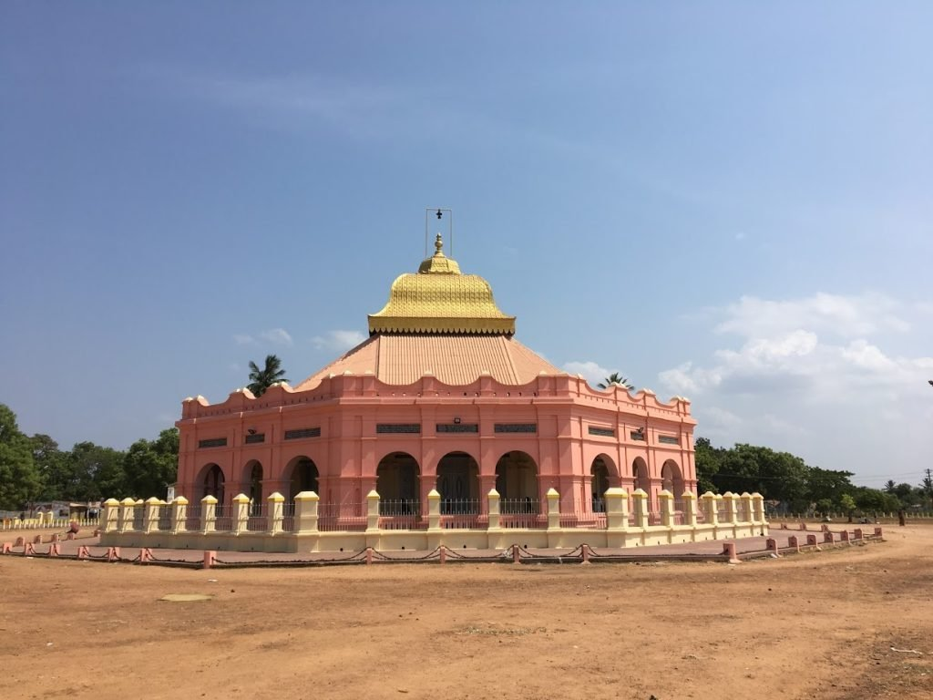
1872 · VADALUR · SATHYA GNANA SABAI
The Hall of True Wisdom.
A place that reveals the soul.
🔥 A single eternal flame
No idols. No statues. No offerings accepted Only a flame behind seven veils — seven layers of ignorance waiting to be lifted.
🏛 Built as the human body
Octagonal, symbols of the eyes and inner organs. 21,600 chain links — the average number of breaths a human takes in one day.
📜 Carved above the entrance
Sathya Gnana Sabai — Vadalur
"Only those who have renounced meat and murder can enter.“ Meaning enlightenment isn’t possible if meat eating and cruelty is still there.

Slide 17
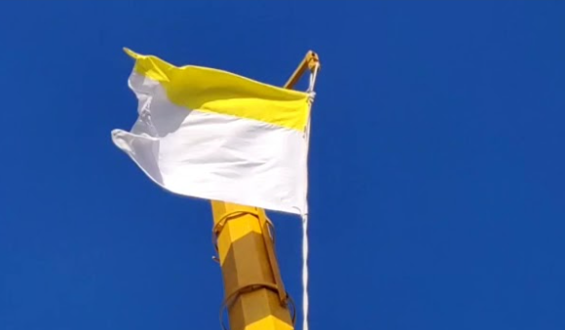
OCTOBER 22, 1873 · SIDDHI VALAGAM · METTUKUPPAM
The hoisting of the Sanmarkkam Flag
Three months before the end, Vallalar raised a flag above his small home at Siddhi Valagam. It’s Not the flag of a nation nor the flag of a religion.
Yellow for immortality. White for purity and compassion.
The flag represents our internal spiritual experience
The Internal Membrane (Cavvu): On the inner side of the brow center, hangs a delicate, thin membrane or film.
Color Correspondence: This internal membrane mirrors the flag's design: its lower surface is white (facing toward the face), and its upper surface is yellow (facing toward the crown of the head)
A century later, John Lennon would imagine a world without nations or divisions. Vallalar had already raised that vision as a flag. The Suddha Sanmarkkam Flag — still flown today.
The Mahamantra
ArutPerunJothi, ArutPerunJothi,
TanniPerunKarunai, ArutPerunJothi.
Vast Grace Light – Vast Grace Light
Unique Vast Compassion – Vast Grace Light
Given that same day. for every person who would ever seek the Grace Light.
It was not necessarily a goodbye.
He was completing what he came to do.

Slide 18
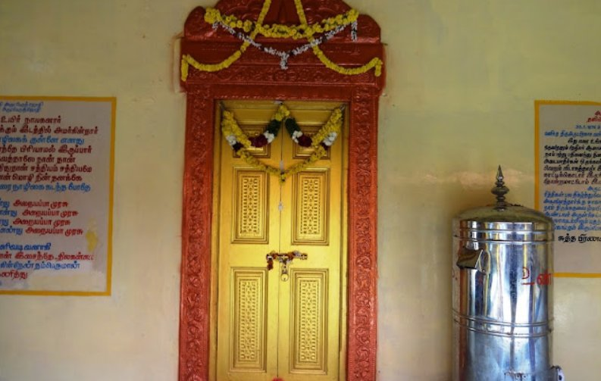
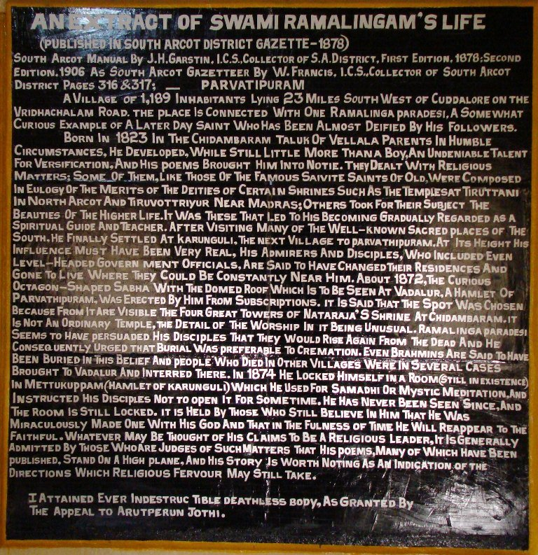
JANUARY 30, 1874 · METTUKUPPAM
He walked into a room in Mettukuppam.
And was never seen again.
OFFICIAL COLONIAL RECORD
District Collector John Henry. Garstin I.C.S., with the District Medical Officer and Superintendent of Police, forced the door open in May 1874. The room was empty. No exit. No remains. It’s said that the room emanated a pleasant smell of camphor, his typical scent from his purified body.
We do not ask you to believe what happened in 1874.
We ask you to examine what he left behind.
Madras District Gazetteer, South Arcot, 1906 — W. Francis I.C.S. · Tamil Nadu State Archives
sanmarkkamlife.org

Slide 19
SAHAKALPI · THE SCIENCE OF DEATHLESSNESS · 04
03
Gnana Degam The Body of Wisdom and Light
The final stage. The Gnana Deham is formed from grace-essence. The Vast Grace Light itself, made form. Fully Attained January 30, 1874 · At Mettukuppam
It Perceives Everything, Everywhere, Simultaneously
From one point: sees, hears, tastes, touches, smells anything anywhere in all universes simultaneously. Every being. Every outcome. Every moment.
It Has Transcended Time Completely
Kālātītāṉ — one who has completely transcended time. Completely. January 30, 1874. He walked in. He entered everything.
Omnipotent, Omniscient, Omnipresent
Has reached the stature of Supreme Godhead. All powerful body, All-knowing and All-present.
“My dear son. You have become the Arut Perum Jothi”
— Thiruarutpa

Slide 20
Not a cowardly escape. To guide everyone.
This is it not to be considered a withdrawal from the world. He announced it in his Thiru arutpa way before his intention to merge back. Devotees believe Vallalar dissolved consciously, fully, into the Vast Grace Light itself. Not to leave existence. To remain within it. To guide the evolution of every living being from inside the fabric of reality.
Announced before his birth. Conscious at conception. Recognized the Divine at five months old. Composed sacred poetry at nine. Fed the hungry without condition. Built a house of wisdom open to all. Changed his own physical body before named witnesses and the colonial government.
On January 30, 1874, in a locked room, with government officials filing the paperwork - he was gone. The room was searched. No body was ever found.
The matter is no longer whether it happened. The question is what it means for all of us and what we can do with it.

Slide 21
Not across generations.
Within one lifetime.
Verified by historical records & witnesses.
A man who left behind a unique blueprint for our evolution.
One that begins with a single act: compassion toward all Life.
sanmarkkamlife.org

Slide 22
Three questions. Most people never ask them.
1.
Do you accept aging?
2.
Do you accept disease?
3.
Do you accept death — as the inevitable, non-negotiable end of life?
You were never actually asked. You were born into a world that already accepted this.
Vallalar said: aging, disease and death are not fixed laws of nature. They are consequences of our ignorance and lack of compassion and purity. He said something no teacher had said before: “Do you accept death? If not — do something about it. Follow my example.”
He claimed the major spoiler of our bodies are 1) Food 2) Sex 3) Sleep 4) Fear and other minor factors
We do not ask you to believe what happened in 1874. We ask you to test what happens in your own body when compassion becomes the basis of your daily practice.

Slide 23
That was 1874.
What does a Tamil saint who dissolved his body in a locked room in colonial India have to do with the world you woke up in this morning?
Everything.
Something that true does not expire.
The kitchen never closed. The flame never went out. The poems never stopped circulating.
Sanmarkkam Life was founded for exactly this.
Not to create something new. To carry something forward.
A living tradition — unbroken since 1867

Slide 24
A BRIEF PRESENTATION ABOUT
SANMARKKAM LIFE
01 Who We Are
05 Why We Are Different
02 Our Mission
06 Voices From the Community
03 Our Values
07 How You Can Help
04 How We Help
08 Connect With Us

Slide 25
WHO WE ARE · SANMARKKAM LIFE
Global. Non-Profit.
Open to All.
🌍
Global Presence
Sanmarkkam Life APS — Association of Social Promotion, Fully-registered.
Participants and country representatives across multiple continents.
We are a strictly non-profit association with no commercial activities. Everything we do is free and donation-based.
We spread the teachings and compassionate vision of Ramalinga Swamigal (Vallalar) through publications, food service, education, technology, and community gatherings — locally and globally.
We have participants and country representatives across multiple continents.
Anyone can join.
As an associate, country representative, volunteer, or simply as a participant in our activities. There’s no prerequisite. No conversion. No conditions. Ever.
🏛
Registered Nonprofit
Association of Social Promotion. Strictly non-profit. Zero commercial activities.
🔓
Zero Barriers
Join as associate, volunteer, or simply participate. No conditions. No exceptions. Ever.
sanmarkkamlife.org

Slide 26
Who we are NOT
✗
Not a “cult” or “sect” – Open to All unconditionally.
✗
No Central Figure – Vallalar is our source of inspiration, not to be worshipped. We are an association built around everyone and we make decisions together in a council.
✗
Not a commercial enterprise – Everything we do is FREE and donation based.
✗
Not making health claims - Our products are offered for cultural and educational purposes, not as medical or therapeutic advice.

Slide 27
What we do not claim.
✗
We do not claim peer-reviewed proof of “biological immortality” or of paranormal claims. We are not after pseudo-science
✗
We do not ask for belief in anything. We are non-dogmatic. We do not claim absolute truth of what we say. We just present facts. You do what you want with them.
✓
We present historical testimony — named, located, documented — under an administration that had no reason to mythologize an Indian mystic.
✓
We invite you to test compassion and Vallalar’s teachings in your own life — and see what changes.

Slide 28
OUR MISSION · SANMARKKAM LIFE
Vallalar’s path. Every person. Every language.
We spread the teachings and wisdom of Samarasa Suddha Sanmarkkam Satya Sangam — founded by Ramalinga Swamigal (Vallalar) — so every person, in every language, can live what he taught.
We are a global facilitator for Suddha Sanmarkkam: translated books and commentaries, recommended foods and herbals, satsang, digital tools, local centers & much more.
We spread universal compassion toward all life and soul unity — the two principles Vallalar identified as the foundation of a world free from suffering.
“Until all living beings can live happily here on Earth — and not in a speculative “heaven.””
Eradicating all types of suffering:
1
Hunger
2
Thirst
3
Ignorance
4
Desire
5
Fear
6
Aging
7
Disease
8
Death

Slide 29
OUR VALUES · SANMARKKAM LIFE
Two principles. One path.
Atma Neya Orumaipadu
Jiva Karunya
ஆன்ம நேய ஒருமைப்பாடு
ஜீவகாருண்யம்
SOUL UNITY
UNIVERSAL ACTIVE COMPASSION
The recognition that all living beings are one interconnected expression of the same light.
What you do to any being, you do to yourself. What you withhold from any creature, you withhold from yourself. There is no separation at the level of the soul.
It is the operating reality Vallalar lived and demonstrated.
Vallalar clearly said in his Perupadesam (Great Teaching) that from the feeling of Oneness, compassion arises.
Not passive empathy. An active, daily practice — extended to every soul, every form of life.
Vallalar taught that compassion is not just sentiment but a science. Withholding food from the hungry, harming any creature, or ignoring suffering creates a damage that no ritual can repair.
Everything good thing arises from practicing this value. Everything bad happens from avoiding this virtue.
sanmarkkamlife.org

Slide 30
HOW WE HELP· SANMARKKAM LIFE
Our Areas of Action
8 interconnected domains
🌿
⚖️
🐾
🥗
Environmental Protection
Human Rights
Animal Welfare
Nutrition
Reducing deforestation, advocating plant-based living, aligning human activity with the natural world.
Rooted in Vallalar's radical rejection of caste and inequality. Every soul has equal rights and dignity.
Vallalar explicitly opposed the killing of animals. Compassion for all life is non-negotiable.
Plant-based and herbal foods as Vallalar prescribed. Free access through the Sanmarkkam Emporium.
💻
🙏
📚
❤️
Technology
Spirituality
Education
Health & Longevity
KarunAI, the Compassionate Intelligence— making the doctrine more accessible.
Spreading Suddha Sanmarkkam — a universal, non-dogmatic path open to every human being.
Translations, commentaries, publications, and social media content making Vallalar’s wisdom accessible.
Vallalar’s science of the body — Sahakalpi — and his recorded knowledge of medicine and healing.
sanmarkkamlife.org

Slide 31
HOW WE HELP· SANMARKKAM LIFE
What We Offer
Everything we offer is always Free.
🌿
🍲
🤝
📖
Solidal Emporium
Community Meals
Satsang
Publications
Free plant-based food & herbal products. Request Freely online. Shipping covered. Donation optional.
Cooked meals served at our physical centers for all those in need
Online & offline meetings, gatherings, and discussions open to everyone.
Translations & commentaries of Thiruarutpa, Urainadai, and other sacred works of Vallalar.
📲
🤖
🔤
🌍
Social Media & Articles
KarunAI
TamilLearn App
More Activities
Educational content about Vallalar's teachings and path, freely shared online.
Our AI guide helping everyone approach the path of Suddha Sanmarkkam.
Making this sacred language accessible to any human being who wants to learn it.
Additional statutory activities aligned with Vallalar's principles of compassion for all life.

Slide 32
KARUNAI · FREE AI GUIDE · SANMARKKAM LIFE
KarunAI
Sample questions
What is Jeeva Karunyam?
Guided by the Light of Suddha Sanmarkkam
How do I begin the path?
A free AI guide rooted in the complete works of Ramalinga Swamigal (Vallalar) —Ask about his doctrine, his food guidelines, non-violence, spiritual practice, plant-based living, & much more.
What is Arut Perun Jothi?
What is Sat-vi-chaaram?
Tracks water use. Use mindfully
I am suffering — what does Vallalar say?
📚
Complete works of Vallalar
🌍
Responds in any language
💧
sanmarkkamlife.org/karunai
Free to use · No login required · 10 questions per day
Arut Perun Jothi · Tani Perun Karunai · Arut Perun Jothi
KarunAI is funded by Sanmarkkam Life. Every response draws water. The session counter and water tracker are visible to encourage mindful use.
KarunAI’s goal is ultimately to make itself unnecessary. Sat-vi-chaaram or self-inquiry — is irreplaceable.

Slide 33
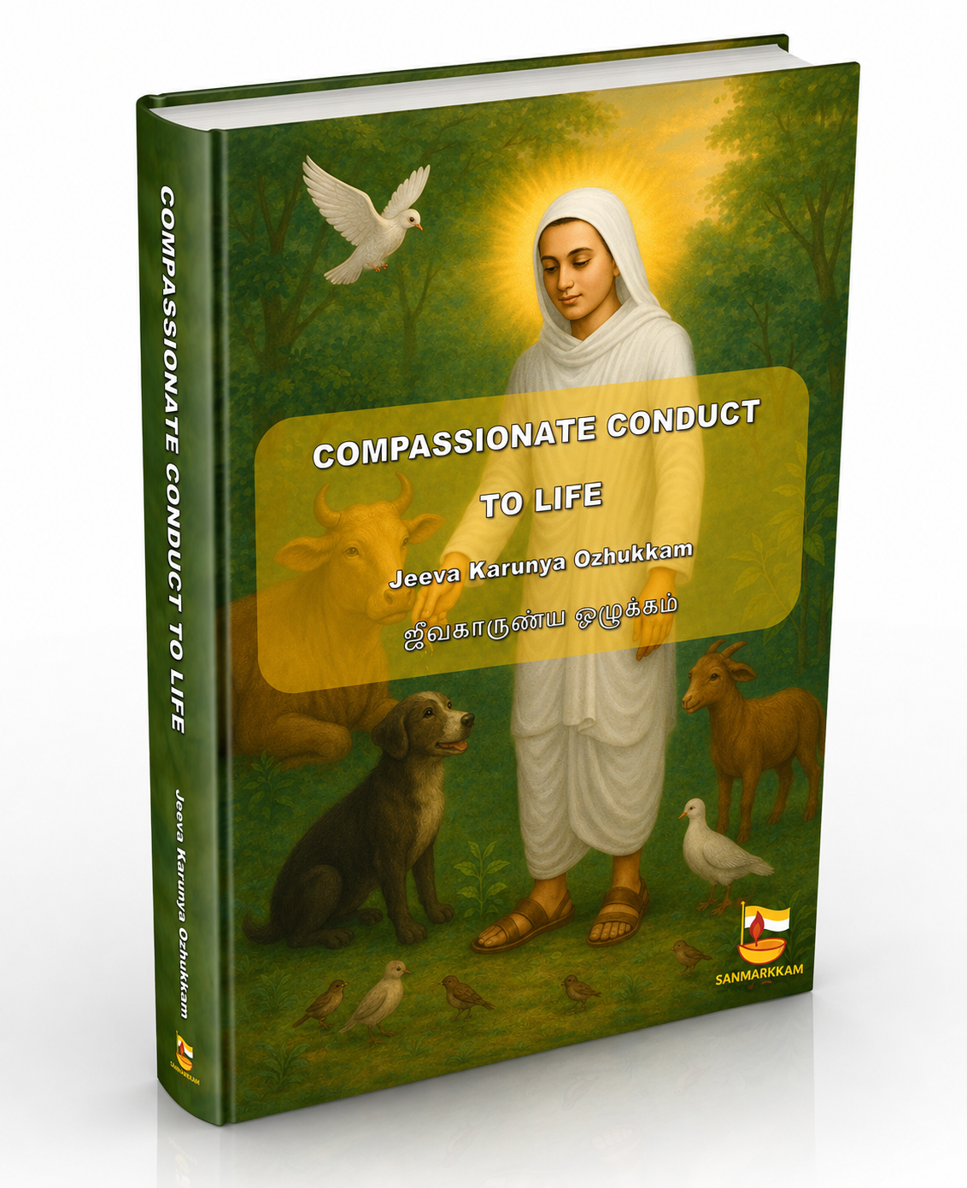
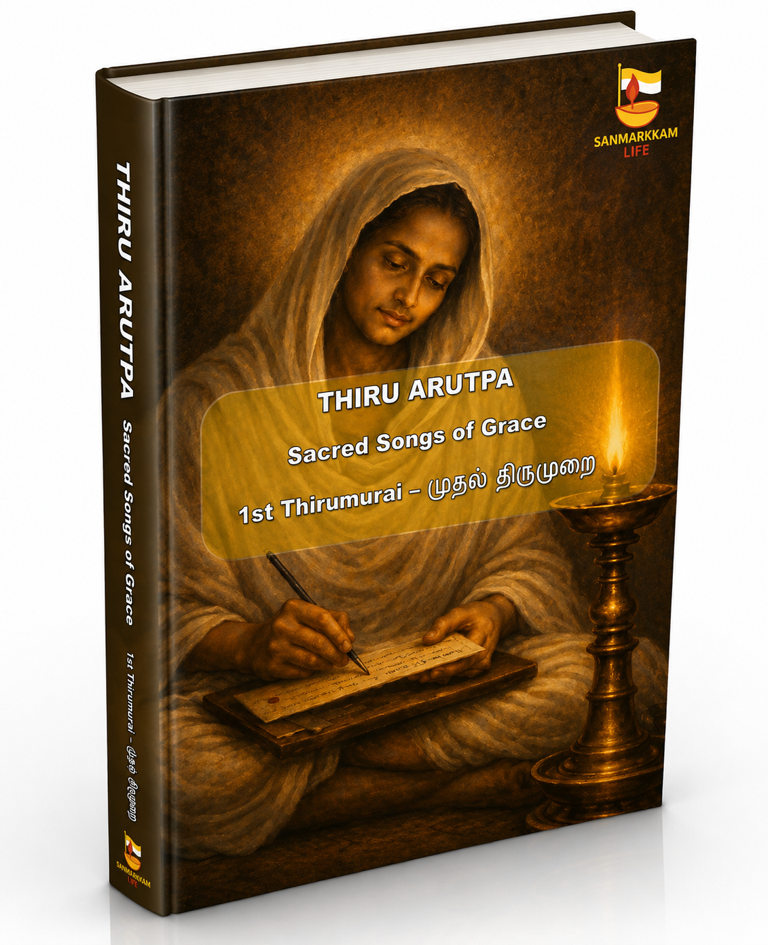
OUR PUBLICATIONS · SANMARKKAM LIFE
Vallalar's words. Freely accessible.
Every publication is offered free of charge. Translations, commentaries, and study aids in multiple languages.
Jeeva Karunya Ozhukkham
Thiru Aarutpa
Urainadai · Prose Work · Commentary on Compassion
The Sacred Poems of Grace
The foremost of Vallalar’s prose texts of Urainaidai — his commentary on Jeeva Karunya Ozhukkham (The Conduct of Compassion for All Life). A foundational text of Suddha Sanmarkkam, now available in multiple languages for the first time.
The complete devotional and mystical poetry of Ramalinga Swamigal — 6,000+ verses documenting his transformation, his compassion, and his doctrine and science. The most comprehensive record of any saint’s inner journey ever committed to writing.

Slide 34
WHY WE ARE DIFFERENT· SANMARKKAM LIFE
A different kind of nonprofit.
MOST NONPROFITS
SANMARKKAM LIFE
✗
Single cause — one domain, one problem (i.e. hunger)
✓
Multi-cause — Several interconnected domains, one root principle
✗
Local reach, limited geography
✓
Local & global — physical centers, digital presence, worldwide representatives
✗
Membership, fees, or affiliation required
✓
Open to all — no conversion, no fee, no discrimination, ever
✗
Treat symptoms — address consequences of a broken world
✓
Treat the root — the absence of Jeeva Karunyam & Atma Neya Orumaipadu
✗
Single tradition or ideology
✓
Universal path — Vallalar’s non-dogmatic science, open to every belief system

Slide 35
WHY WE ARE DIFFERENT · SANMARKKAM LIFE
One root. One path.
Most organizations treat the consequences of a world without compassion. We address the cause.
“When compassion toward living beings is absent, suffering is inevitable. The law of the jungle returns.”
— Ramalinga Swamigal (Vallalar) in Jeeva Karunya Ozhukkham
1
We treat the root, not the branch
Climate crisis, pandemic, wars, animal abuse, and poverty share one cause: the absence of Jeeva Karunyam and Atma Neya Orumaipad. Most organizations treat each crisis separately. We address what produces them all.
2
Entirely free. No hierarchy. No conversion.
No cost. No membership. No religion to leave. No belief to adopt. Not a marketing strategy. This is how Vallalar’s free kitchen has operated since 1867. The path is open to every human being, without exception.
3
A living, documented tradition since 1867
Not theory. An unbroken path verified by colonial administrative records, named historical witnesses, and 150 years of continuous practice. You are not asked to believe it. You are invited to test it in your own life.

Slide 36
JEEVA KARUNYAM · ATMA NEYA ORUMAIPADU · THE ROOT
We have been treating symptoms.
Vallalar identified two missing principles behind every human crisis:
Jeeva Karunyam
(Active compassion for all life) · Atma Neya Orumaipadu (soul unity - seeing all beings as yourself)
🌡️
Climate & Environment
🧫
Disease & Pandemic
⚔️
Wars & Division
80% of deforestation tied to industrial animal systems — a direct consequence of absent compassion for life.
75% of emerging infectious diseases originate in animal exploitation. Broken Jeeva Karunyam.
A species that cannot feel oneness with other beings cannot build peace with its own kind.
🏠
Hunger & Poverty
🧠
Mental Suffering
🦴
Aging & Disease of the Body
Inequitable resources distribution rooted in the absence of soul unity — the failure to see the other as oneself.
Fear, desire, and ignorance flourish when we live in separation from all life. Soul unity is the cure.
Vallalar taught that the body degrades when compassion and purity are absent. This is a law, not fate.
The next step in human evolution is not a larger brain. It is a larger compassion — and a deeper recognition of our oneness.

Slide 37
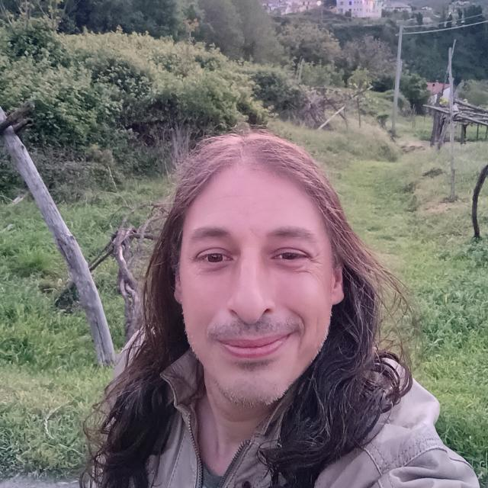
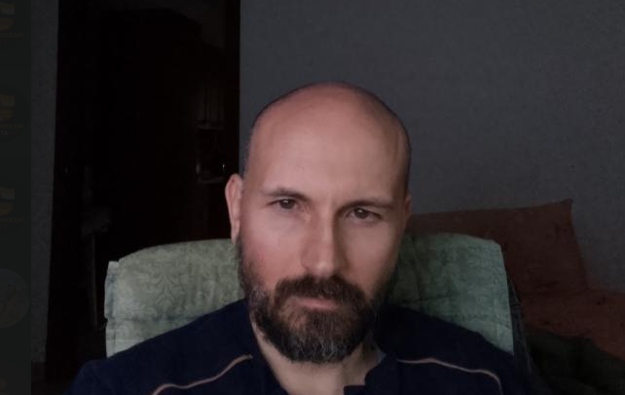
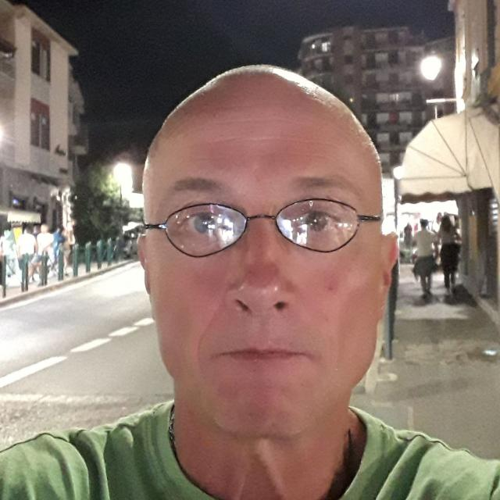
VOICES FROM THE COMMUNITY · SANMARKKAM LIFE
Voices From the Community
What practitioners of Suddha Sanmarkkam say.
““
““
““
“When by pure chance I began listening to Vallalar’s words, my soul felt that purity I had been searching for — and wanting to know ever more, I joined the project as Vice-President.”
“The teachings found in these documents are extremely useful for a good spiritual path and for improving the quality of life. I recommend everyone to follow these precepts as best they can on their own journey — in my view, they can only bring great benefit.”
“I met Sanmarkkam Life by chance, Ramalinga drew me in — a mystic of depth, famous above all for placing compassion toward every living being at the summit of his teaching. Four years ago I began yoga practice in Turin. Through Sanmarkkam Life, I went deeper.”
— Vittorio Saviello
— Mirko Nardini
— Ivon Colombano

Slide 38
WHY HELP · SANMARKKAM LIFE
Giving here gives back.
Our donors and volunteers report something unexpected — they receive as much as they give.
“Donating and/or volunteering to a cause that addresses the root of all suffering — not just a symptom — gives a sense of meaning that ordinary charity hardly does.”
😀
🧠
🤝
✨
Increased Happiness
A Sense of Meaning
Genuine Connection
Alignment with the Path
Contributing to the wellbeing of all living beings, not just humans, activates a deeper joy.
Working on the root cause and not just the symptoms — gives your contribution a deeper meaning into your life.
You join a community of people across the world walking the same path, with no hierarchy.
Vallalar taught: giving freely is itself a practice of Jiva Karuna. You practice as you contribute.

Slide 39
This is your door.
A teaching alive since 1867. Vallalar’s mother fed one stranger at her door. Look what followed.
🚀 Start here
🛣️ Walk the path
sanmarkkamlife.org/start
sanmarkkamlife.org/journey
Everything in one place: books, translations, Solidal Emporium, community links etc.. All in one Place. No waiting. Start wherever calls to you.
We take you by the hand. A guided email journey through Vallalar’s wisdom — delivered step by step, at your own pace. Gently to your email. Sign up and we walk with you.
❤️
🙌
🌍
Donate
Volunteer
Represent
sanmarkkamlife.org/donate
sanmarkkamlife.org/volunteer
sanmarkkamlife.org/represent
Fund food programs, emporium products, global outreach & more.
Write, articles, edit videos, design, organize, cook. Come as you are. Bring what you have.
Open a door in your country. Your language. Your culture. The same door Vallalar opened in 1867.

Slide 40
CONNECT WITH US · SANMARKKAM LIFE
Stay connected. Stay on the path.
Daily teachings, community updates, and free content — in multiple languages. Follow us wherever you are.
📷
📺
🎵
Instagram
YouTube
TikTok
@sanmarkkam_life
@sanmarkkam_life
@sanmarkkam_life
Short clips, community life, and daily inspiration from Vallalar's teachings.
Full-length talks, translations read aloud, and documentary content.
Quick insights, quotes, and introductions to Vallalar’s world for new audiences.
✉️
Email us directly
international@sanmarkkamlife.org
For partnerships, media requests, volunteer coordination, or any inquiry. We read every message.
sanmarkkamlife.org
Sanmarkkam Life APS · Registered registered nonprofit · Global reach

Slide 41
ARUT PERUM JOTHI · TANNI PERUM KARUNAI · ARUT PERUM JOTHI
The Vast Grace Light. It is still here.
It has always been here. In you, as much as in anyone.
The door is open. You are invited to walk through it.
Sanmarkkamlife.org/start

